Slide 1
RISK CPU
By Nicholas Holleman

Slide 2
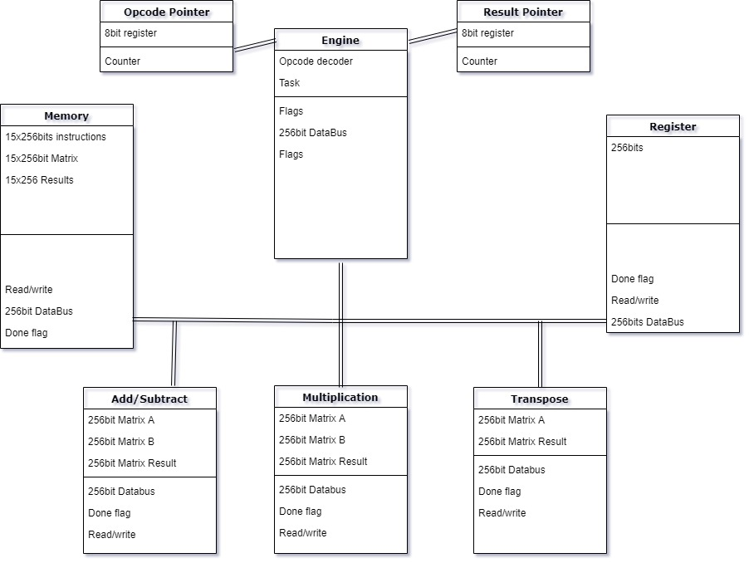
Top level Diagram

Slide 3
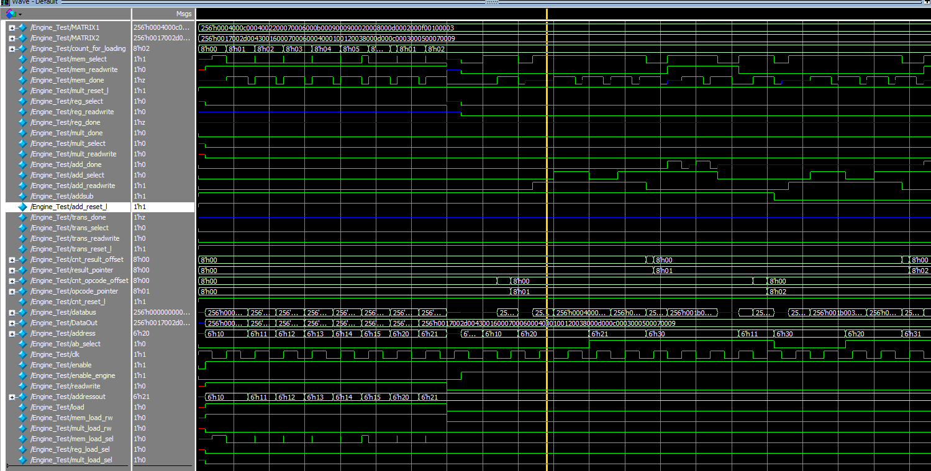
Wave Forms
Engine Running

Slide 4
Results
OpCode 1
OpCode 4
R[ 27] [ 57] [ 71] [ 56]
R[ 14] [ 12] [ 15] [ 10]
R[ 27] [ 58] [ 21] [ 25]
R[ 5] [ 20] [ 23] [ 12]
R[ 966] [ 294] [ 756] [ 126]
R[ 1890] [ 252] [ 2352] [ 210]
R[ 2814] [ 168] [ 546] [ 294]
R[ 924] [ 42] [ 504] [ 378]
OpCode 2
OpCode 5
R[ 23] [ 45] [ 67] [ 22]
R[ 7] [ 6] [ 4] [ 1]
R[ 18] [ 56] [ 13] [ 12]
R[ 3] [ 5] [ 7] [ 9]
R[23336] [11676] [45192] [10794]
R[20406] [24360] [15692] [25284]
R[49796] [23184] [ 5150] [15750]
R[65226] [ 9114] [30072] [ 9912]
OpCode 3
R[ 23] [ 7] [ 18] [ 3]
R[ 45] [ 6] [ 56] [ 5]
R[ 67] [ 4] [ 13] [ 7]
R[ 22] [ 1] [ 12] [ 9]

Slide 5
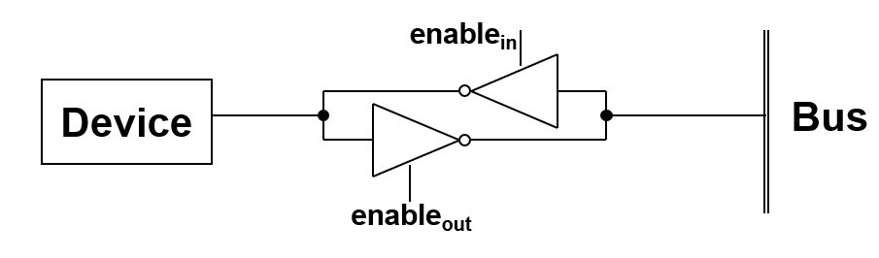
Some Hard & Satisfying

Slide 6
Questions?
The ANSWER is always 42.

